Slide 1
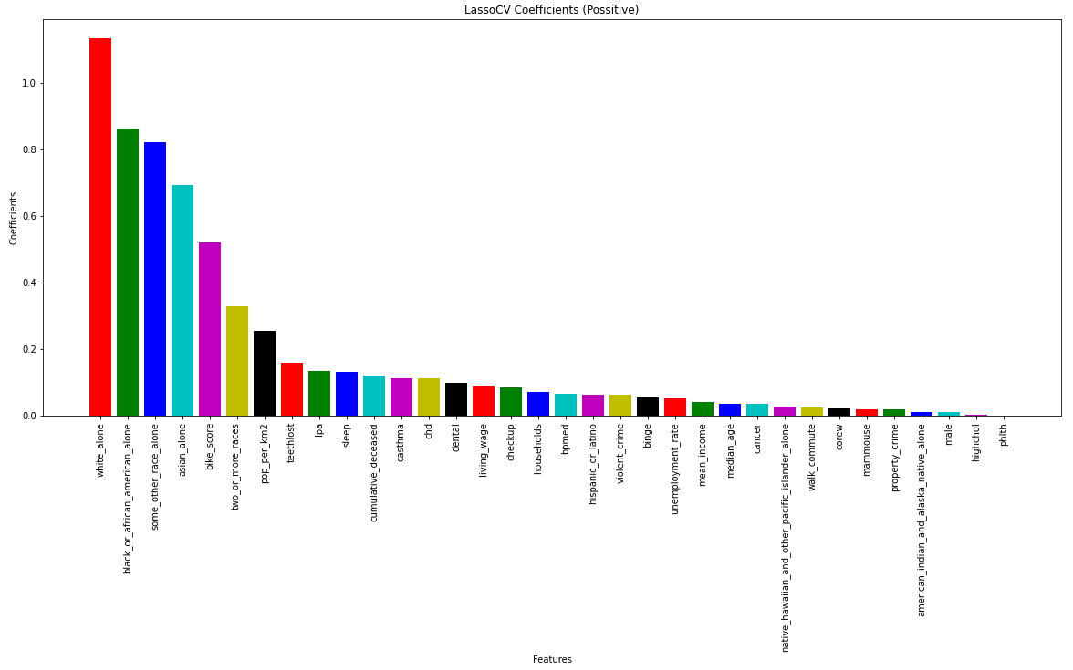
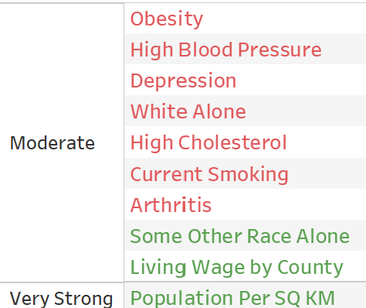
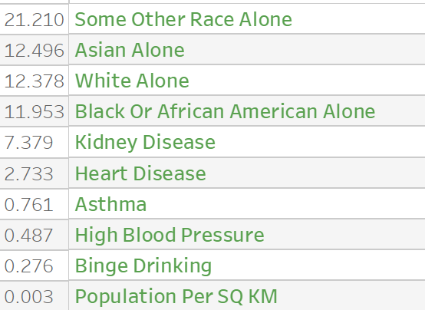
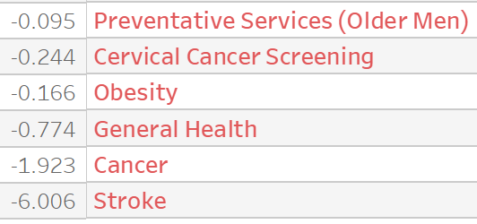
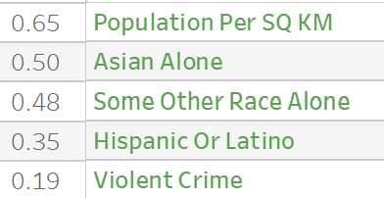
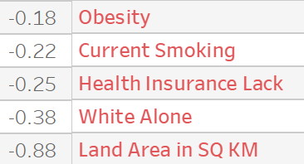
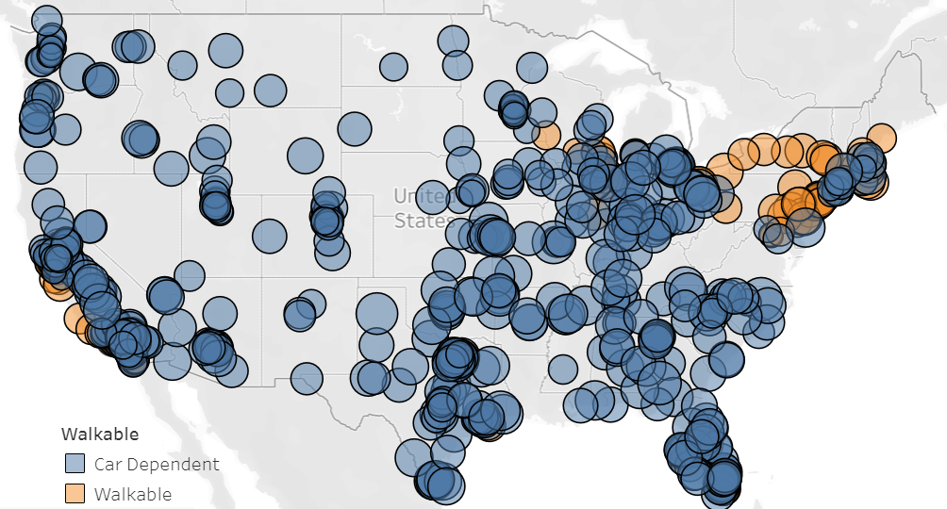
Walkable Cities
DS4A Empowerment Team 27: Sola Agagu | Daniel Bernal | Omar Ibarra | Chanel Lee | Damilola Salami
Modeling
Some models and tools we used were multiple linear regression, PCA linear regression, Bootstrapping, interpolation, Lasso Linear Regression with L1, and Lasso CV.
Background
Most American cities are designed for cars instead of people. In this project, we explore how the walkability of a city is related to it’s demographics and quality of life variables. We aim to encourage city planners and policy makers to invest in walkability and implement pedestrian-centric city designs.
Analysis and Hypothesis Testing
We used the following methods to determine what variables are related to walkability during our exploratory data analysis:
-Correlations
-T-tests
-Logistic Regression
Data
We collected data from the Census, CDC, EPA, FBI, and walkscore.com. We had 760 cities with 75 variables. After removing columns and rows with 25% or more missing values we had 727 cities with 60 variables.
Features: Demographic and Quality of Life categories
Response: Walk Score
Fig 3 – Lasso regression coefficients for variables.
Results
According to our analysis, these variables: -White Alone
-Arthritis
-Depression
-High Blood Pressure
-High Cholesterol
-Obesity
-Current Smoking
were significant and negatively associated with walkability. While these variables:
-Population per SQ KM
-Some Other Race Alone
-Living Wage
were positively associated with walkability.
Fig 2 - Left: List of variables with moderate and strong correlation with walk score
Right: List of statistically significant variables for logistic regression with coefficients
Bottom: Top and bottom five list of statistically significant variables for t-test and the percent difference between the means of walkable and car dependent cities
Note: The green variable have a positive relationship to walkability and the red variables have a negative relationship to walkability.
Fig 1 - Map of walkable vs car-centric cities in our dataset

